Slide 1
Front End Engineering-II Project
[ Team -2 ]
Jaivardhan Khanna : 2210990429
Jashan Jot Kaur Gill : 2210990436
Jasmine Rathor : 2210990450
Faculty Coordinator: Baljit Kaur
Chitkara University Institute of Engineering and Technology,
Chitkara University, Punjab

Slide 2
Table of Contents
Introduction
Problem Statement
Technical Details
Key Features
Conclusion
References/Links used

Slide 3
Introduction
In this project, we will be creating Social Media Dashboard . The project will aggregate and display data from a social media (Instagram). The project is made by implementing HTML, CSS, and Javascript and the data is fetched by using an Instagram api available from rapidapi .
By using the help of asynchronous fetch methods we have retrieved data from the above api and displayed it on our website by integrating it with html and css.

Slide 4
Problem Statement
This project aims to show the use of api(s) in order to fetch metadata of provided username from instagram.com and display that info on a HTML page.

Slide 5
Technical Details
The project has used HTML, CSS, and Javascript.
1.) In HTML , we have used :
<div>
The <div> tag is used to define a division in an HTML document. It is a container that can hold other HTML elements.
<nav>
The <nav> tag is used to define a section of navigation links.
<ul>
The <ul> tag is used to define an unordered (bulleted) list.
< li >
The < li > tag is used to define a list item.
<input>
The <input> tag is used to create an input field where users can enter data.
<button>
The <button> tag is used to create a clickable button.

Slide 6
Technical Details
<a>
The <a> tag is used to create a hyperlink.
<img>
The <img> tag is used to embed an image in an HTML document.
<title>
The <title> tag is used to define the title of an HTML document.
<main>
The <main> tag is used to define the main content of an HTML document.
<span>
The <span> tag is used to group inline elements and apply styles to them.
<br>
The <br> tag is used to insert a line break.
<p>
The <p> tag is used to define a paragraph.

Slide 7
Technical Details
2.) In CSS we have used :
overflow-x: This property sets what shows when content overflows a block-level element's left and right edges.
position: This property specifies the type of positioning method used for an element. It can have values like fixed and relative.
z-index: This property specifies the stack order of an element. An element with a higher stack order is in front of an element with a lower order.
background-color: This property sets the background color of an element.
display: This property specifies the display behavior of an element.
width: This property sets the width of an element.
height: This property sets the height of an element.
margin: This property sets the margin of an element.

Slide 8
Technical Details
padding: This property sets the padding of an element.
left: This property sets the left position of a positioned element.
top: This property sets the top position of a positioned element.
color: This property sets the text color of an element.
list-style-type: This property sets the list-item marker style.
line-height: This property sets the height of a line box.
filter: This property sets visual effects on an element.
font-size: This property sets the font size of the text.
font-weight: This property sets the weight of the font.
display: This property specifies the display behavior of an element.
cursor: This property specifies the type of cursor to be displayed.

Slide 9
Technical Details
3.) In Javascript we have used :
get_data(): This asynchronous function fetches data from the specified URL using the fetch API and updates the DOM based on the retrieved data. It also handles errors in case the API fetch fails. [this is a self made function]
show(): This function displays an alert and redirects the user to a specified URL when a certain condition is met. [this is a self made function]
document.getElementById(): This tag is used to access and manipulate elements in the HTML document by their respective IDs.
document.getElementById().src: This tag is used to set the source of an image element.
document.getElementById().title: This tag is used to set the title attribute of an element.
document.getElementById().innerText: This tag is used to set the text content of an element.
document.getElementById().style: This tag is used to manipulate the CSS styles of an element.
document.getElementById().setAttribute(): This tag is used to set attributes of an element dynamically.

Slide 10
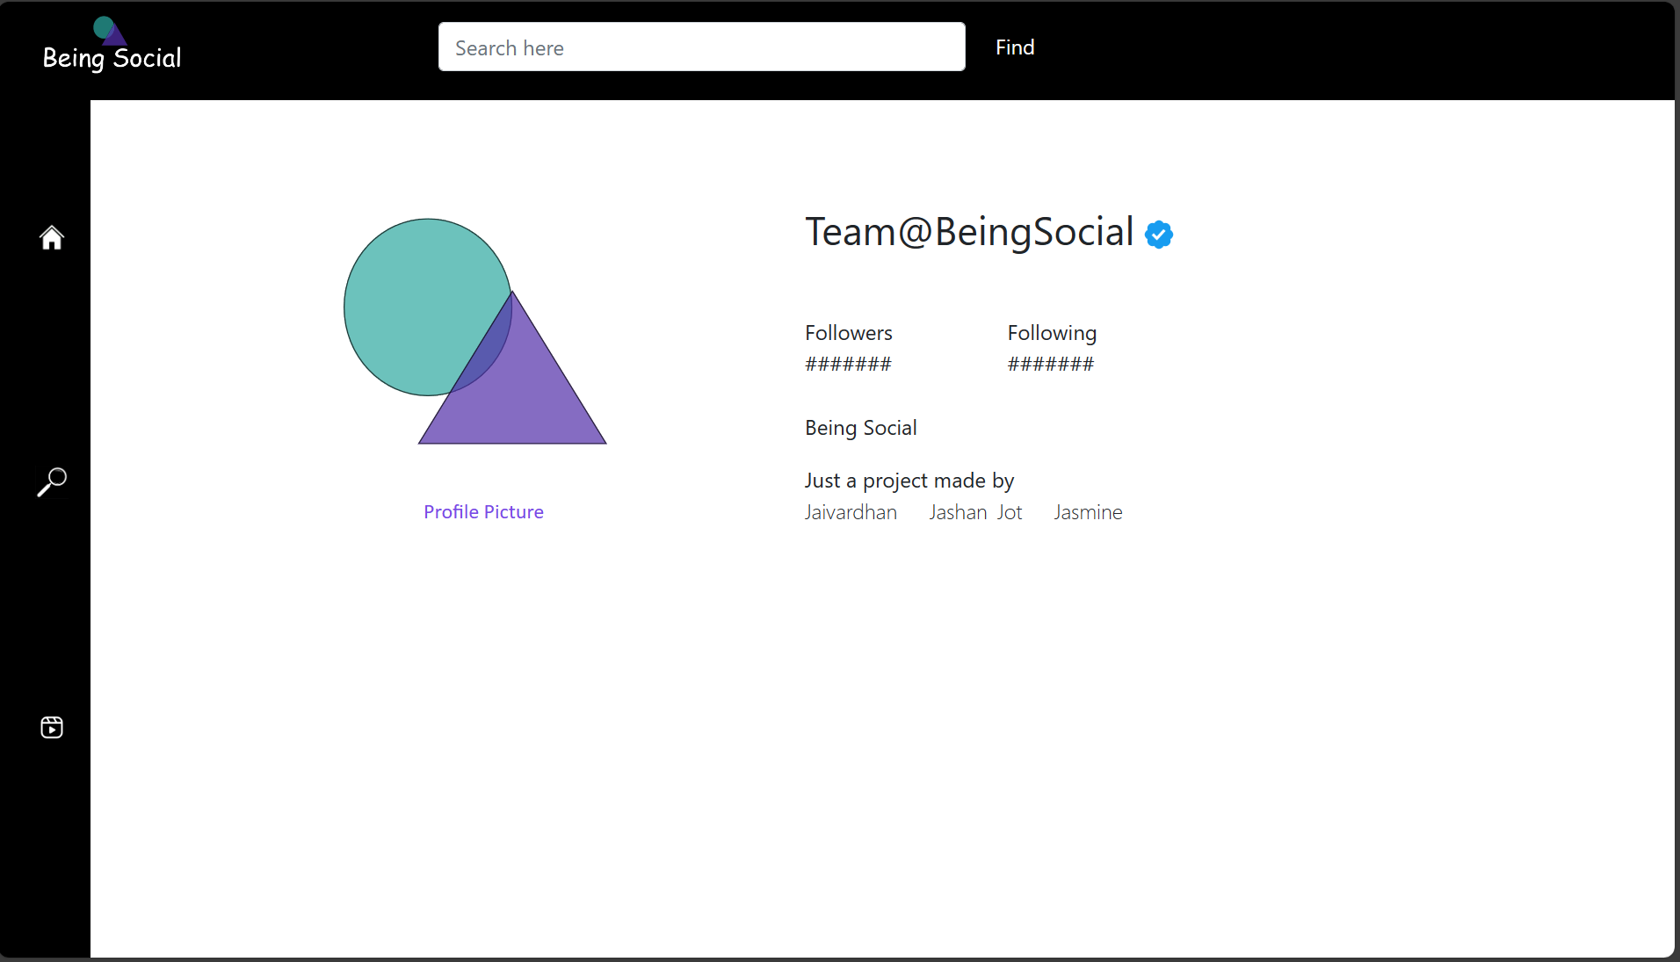
Project Highlights
Searchbar that take username as the input
Username to be displayed
Searchbar anchor
Profile Picture link
Bio of the user
No. of Followers and Following of the user

Slide 11
Conclusion
A social media dashboard serves as a powerful tool for individuals and businesses. By aggregating data from multiple sources into a centralized location, these dashboards analytics, scheduling, listening, and customization, social media dashboards empower users to monitor their online presence, track key metrics, and make informed decisions to enhance their digital marketing efforts.

Slide 12
References/Links used
MDN Web Docs - https://developer.mozilla.org/en-US/docs/Web
W3Schools - https://www.w3schools.com/
CSS-Tricks - https://css-tricks.com/
Codecademy - https://www.codecademy.com/
Stack Overflow - https://stackoverflow.com/

Slide 13


